Slide 1
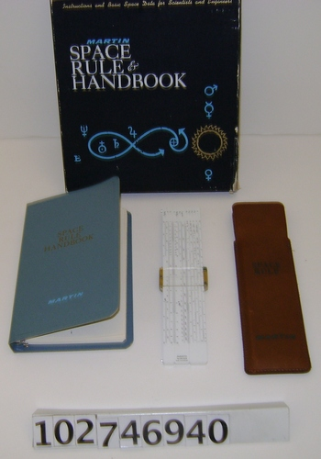
The Rocket Science Behind the Martin Space Rule and Handbook
Will Marchant, UC Berkeley Space Sciences Lab

Slide 2
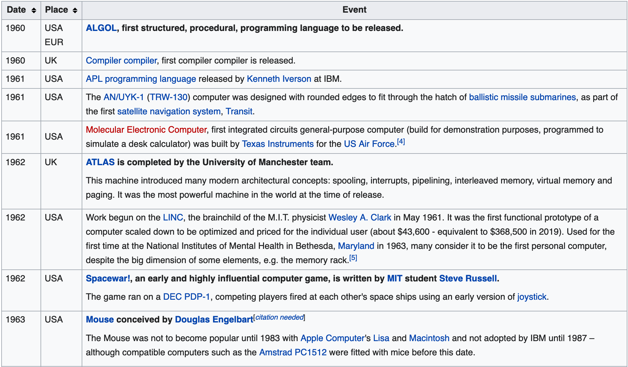
Context 1962
Batch computing
Small signs of personal computers
1962-02-20 John Glenn
(1 year after Gagarin)
1962-04-26 Lockheed A-12
Wikipedia: https://tinyurl.com/yy5oprdh

Slide 3
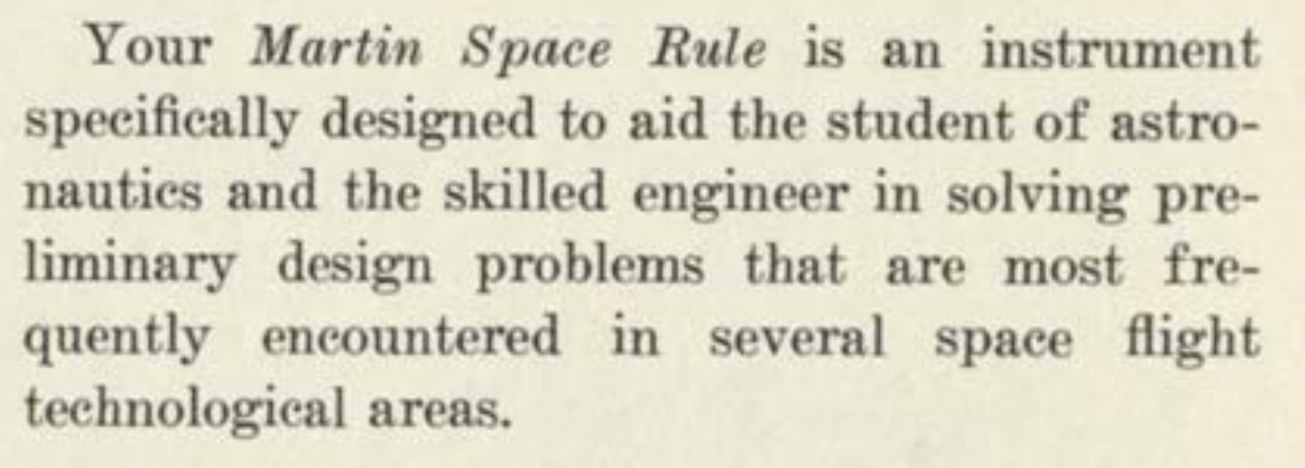
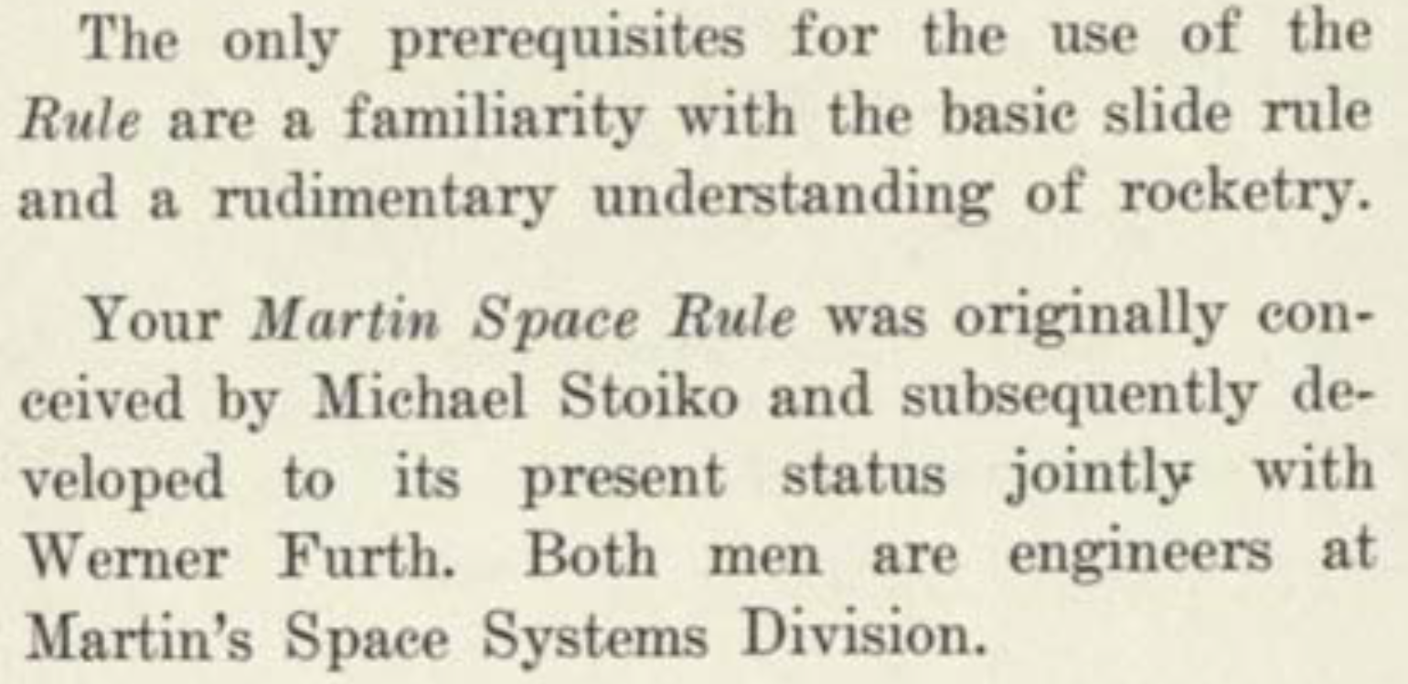

Slide 4
The Authors - Selected Highlights
Michael Stoiko (1919-2010)
WW-2 Marine aviator
Aerospace engineer
Authored 12 books on rocketry
Advocated international cooperation in space
Led the Advanced Space Vehicle team at Martin (later Lockheed Martin)
Worked on the Gemini space program
Werner Furth (1930 – 2012)
Engineer at Martin's Space Systems Division
Worked on energy systems at Martin Marietta
Lead author on a Martin Marietta Environmental Energy Plan
-WorldWideScience.org
-F. N. Rasmussen, The Baltimore Sun, 2010

Slide 5
The Authors - Who were they?
Michael Stoiko
Nothing can keep man from exploring space; the trend in history is unmistakenly toward interplanetary travel.
-Michael Soiko, Soviet Rocketry, 1970
Werner Furth
A brilliant mind, coupled with a keen sense of humor, witty poems, equations on the blackboard, ink stains on his shirt, cigar ashes everywhere, his slogan of "Furth things first…." -Anne Torres, remembrance, 7/23/2012

Slide 6
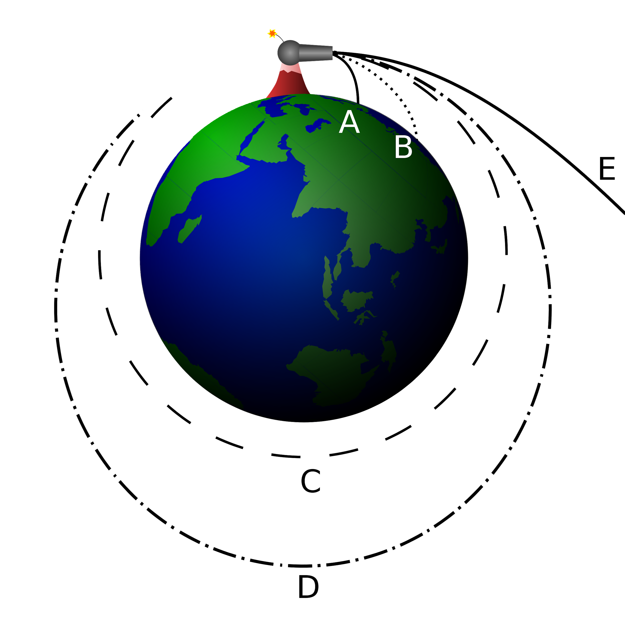
Planets “suck”
Newton’s Cannonball
Leaving the atmosphere is expensive
https://en.wikipedia.org/wiki/Orbit

Slide 7
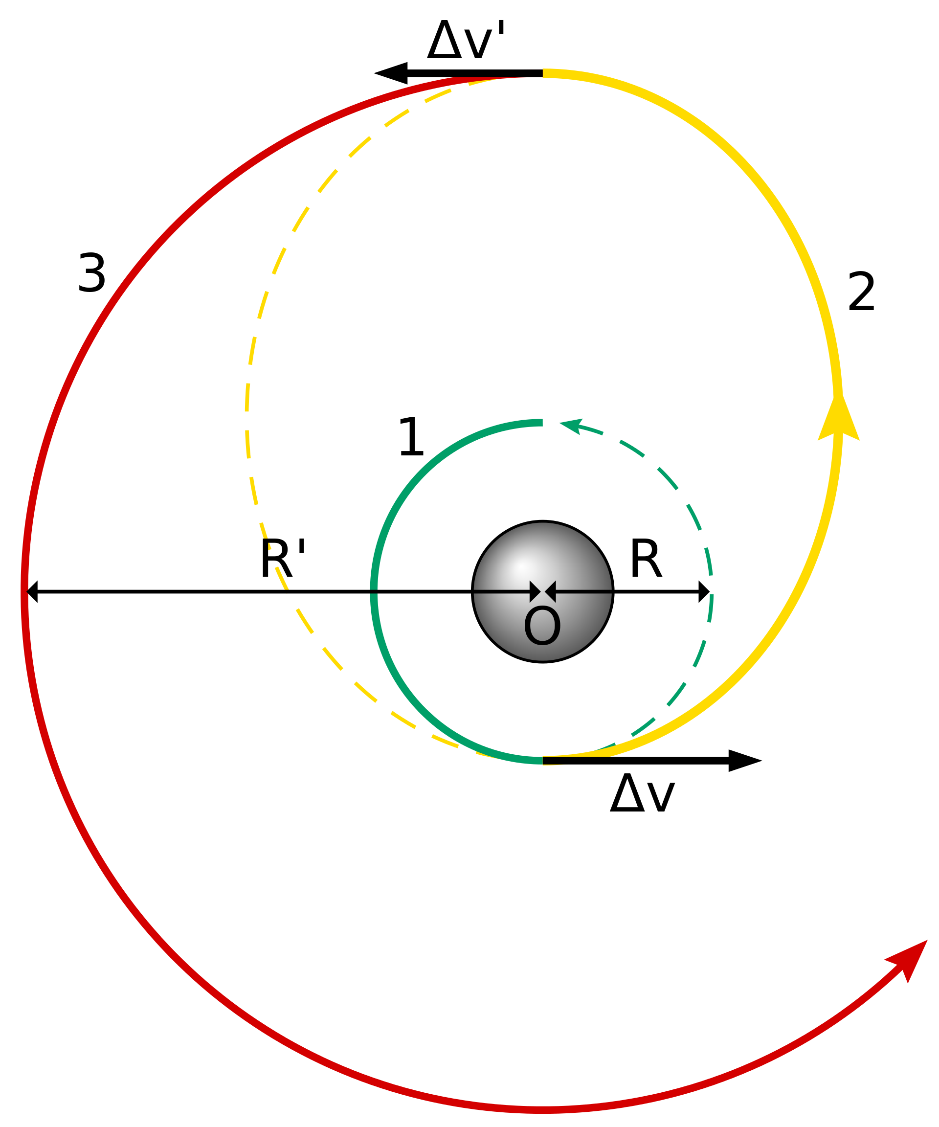
It’s All About Velocity
Efficiency is crucial
Sadly, no “space drives”...
Earth’s rotation can help or hurt
Earth’s orbit around the Sun can help or hurt
“Characteristic Velocity” is a total “cost” of a mission
https://en.wikipedia.org/wiki/Hohmann_transfer_orbit

Slide 8
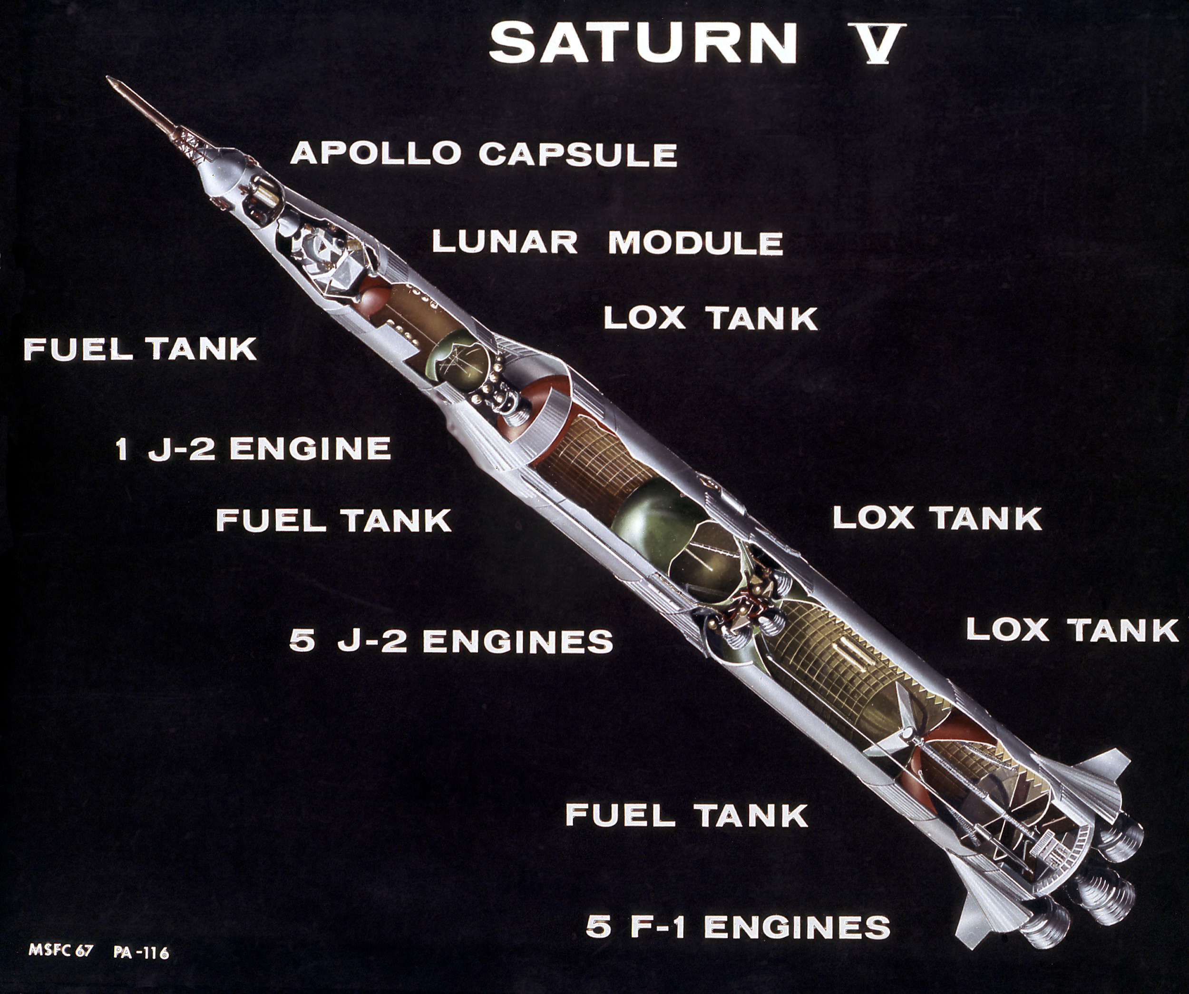
Big Rockets...
Space Shuttle SRB: 250
Shuttle Main Engine: 450
Nuclear Thermal: 850
Ion Thruster: 3000
VASIMIR: 12000
Tsiolkovsky rocket equation:
dV = Isp G0 ln( m0 / mf )
Is the change in velocity from expending propellant and depends upon the efficiency of the propellant.
Isp is “specific impulse” efficiency
G0 is gravitational constant of ~9.8m/s^2
M0 is initial mass
Mf is final mass
https://solarsystem.nasa.gov/news/337/what-was-the-saturn-v/

Slide 9
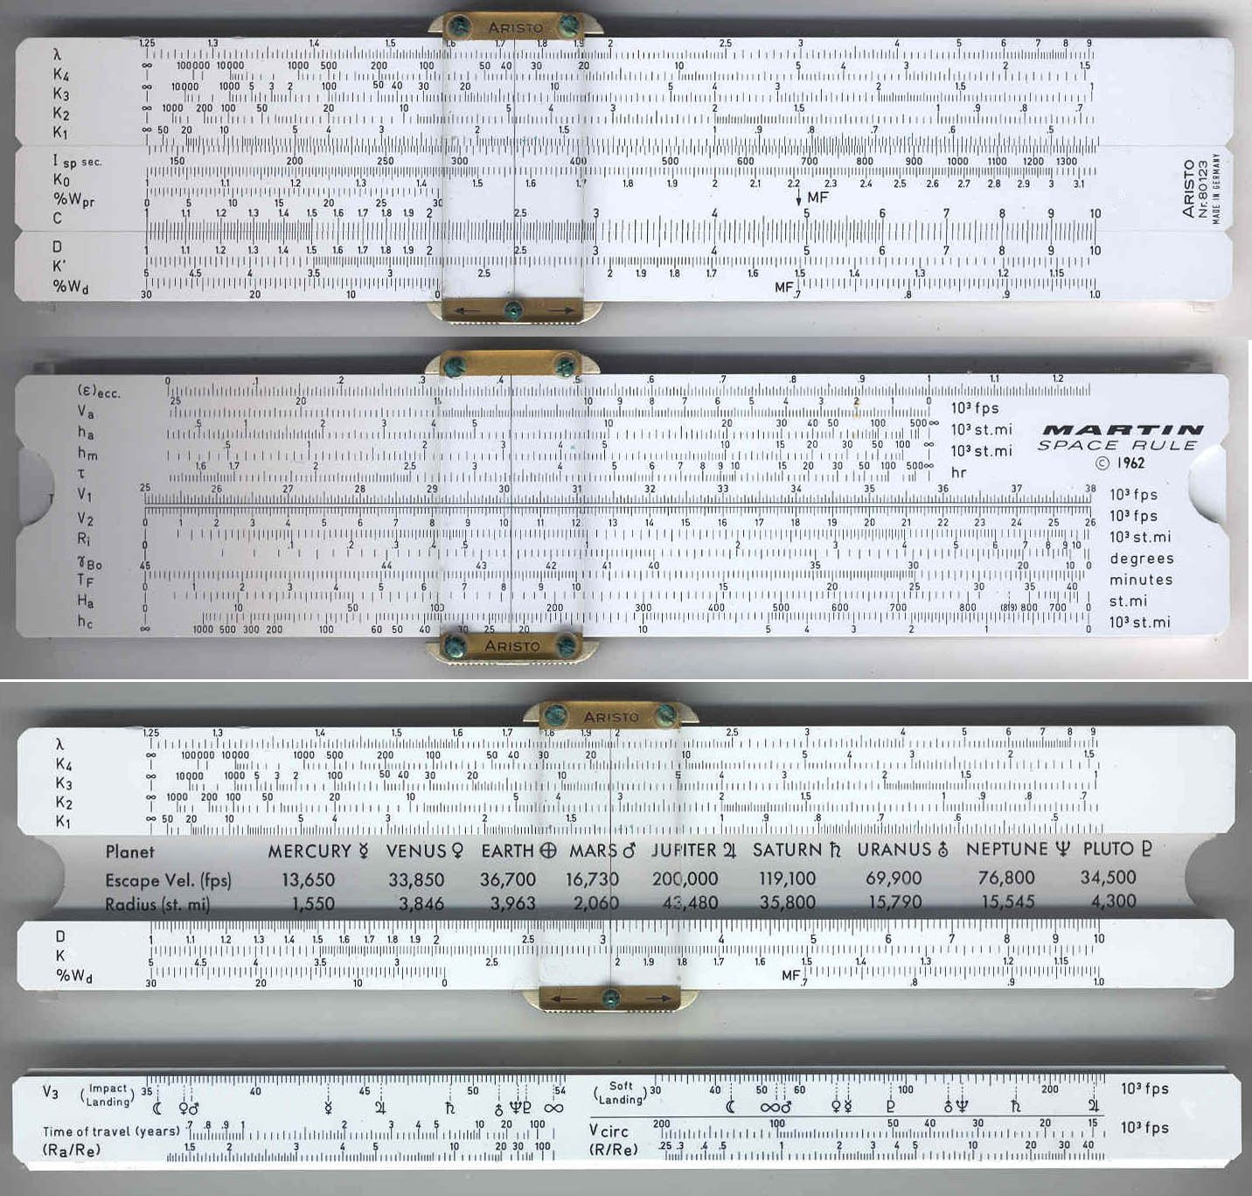
https://www.sliderulemuseum.com/Aristo/Aristo_80123_MartinSpaceRule_1962_RodLovetteCollection.jpg

Slide 10
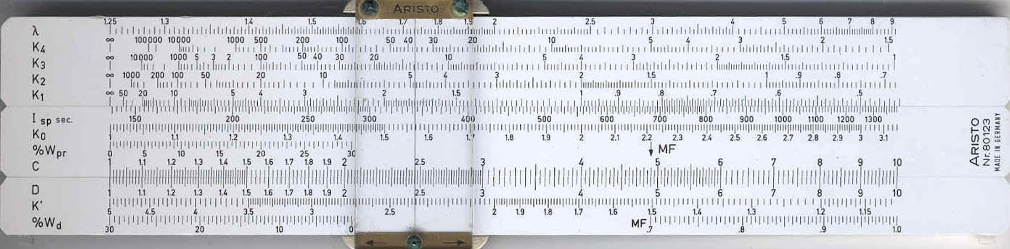
The Front Scales
Conventional C and D with slide front
Mass fraction and booster design on front
Up to four stages

Slide 11
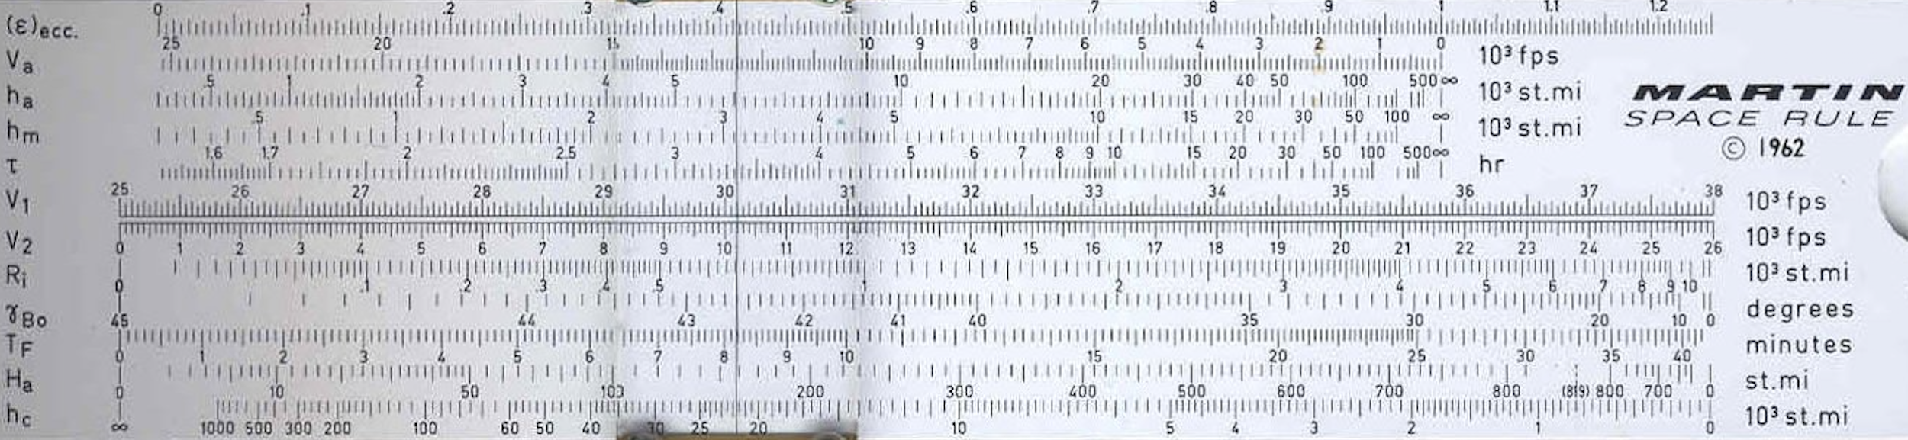
The Back Scales
Earth orbit scales on back (mostly) top
Ballistic missile “exterior ballistics” scales on back bottom

Slide 12
The Slide Back Scales
Interplanetary scales on the slide back
Soft and hard landings!
Gutter has useful reference information

Slide 13
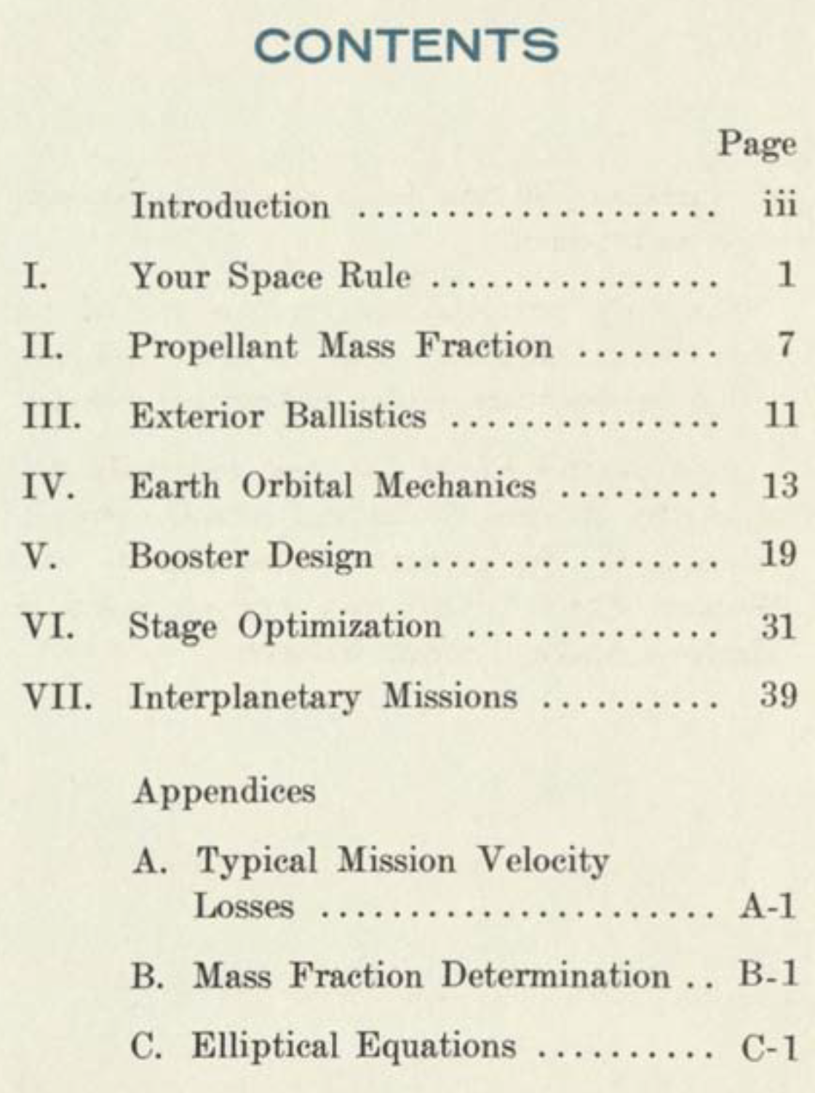
The Handbook
1962
Tutorial format, but assumes some background
Lots of examples

Slide 14
References About the Authors
https://airandspace.si.edu/support/wall-of-honor/michael-stoiko
https://www.baltimoresun.com/bs-xpm-2010-12-24-bs-md-ob-iphone-michael-stoiko-20101223-story.html
https://www.dignitymemorial.com/obituaries/bel-air-md/werner-furth-5164895
https://worldwidescience.org/topicpages/m/martin+marietta+astro.html

Slide 15
Martin Rule References
https://www.computerhistory.org/collections/catalog/102746940
https://sliderules.lovett.com/aristo80123/aristo80123.htm
https://uksrc.org.uk/uksrc/fulldetails.cgi?match=8
https://hpinspace.wordpress.com/2009/09/13/aristo-80123-the-slide-rule-to-have/

Slide 16
Aerospace Slide Rule References
https://www.sliderulemuseum.com/Aerospace.htm
http://www.projectrho.com/public_html/rocket/astrodeck.php#id--Computers--Slide_Rules
https://rc.library.uta.edu/uta-ir/handle/10106/27215
Questions?
https://www.ssl.berkeley.edu/~marchant/

